Slide 1
TAK Server - AD/LDAP
You should have a TAK Server fully stood up to proceed.

Slide 2
TAK Server - AD/LDAP Integration
Generally, with either AD or LDAP domains you have an established certificate authority and then an authentication method, either a CAC (common access card)/token or username and password.
(Required) - Create a TAK service account to allow the server to query information from the AD/LDAP domain.
(Recommended) - Create a certificate signing request and recreating the java and pkcs12 trust stores to have our server signed by the domain issuing authority.
(Optional) - Configure certificate autoenrollment using AD (Active Directory) Certificate Services.
Notes:
# Disregard the <File/> line, this gets added back after restart. If you try to validate the file with that added back it will fail. ./validateConfig.sh
# AD = Active Directory Provides a database and services for identity and access management. LDAP = Lightweight Directory Access Protocol. Interface for communicating with directory services, such as AD.
#One of the advantages of using either AD or LDAP is that you can have centralized management of users and groups. The trade-off is setup difficulty.

Slide 3
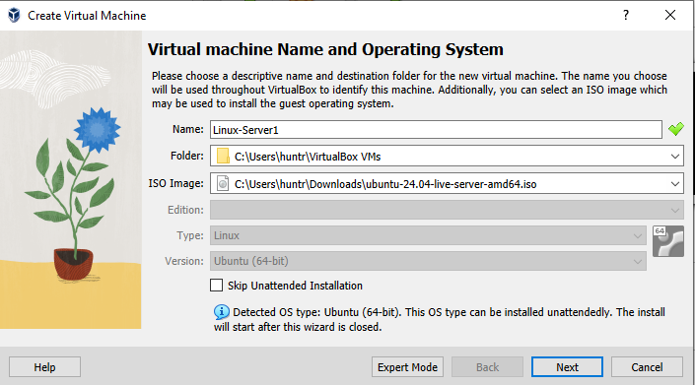
TAK Server - AD/LDAP Integration - LDAP Server Setup
Create a Ubuntu (or your choice of OS).
Download your choice of OS boot iso.
https://ubuntu.com/download/desktop
Within Oracle Virtual Machine select “New”
Fill in the appropriate fields:
Name: <name your server>
Folder: <change location if needed>
ISO Image: <select the downloaded image>
Select “Next”
Notes:
# You can also do this on a standard boot ISO, is does not have to be a server ISO.

Slide 4
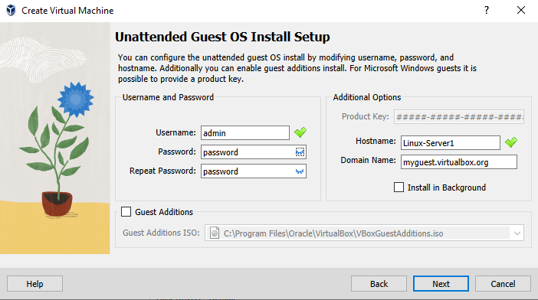
TAK Server - AD/LDAP Integration - LDAP Server Setup
Here you can change the username and password to whatever you’d like:
Username: admin
Password: password
You can also change the name of the host, and the domain name is you desire.
When done select “Next”

Slide 5
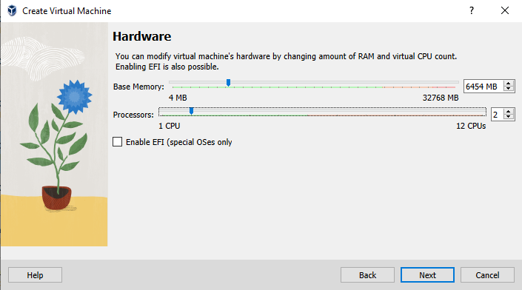
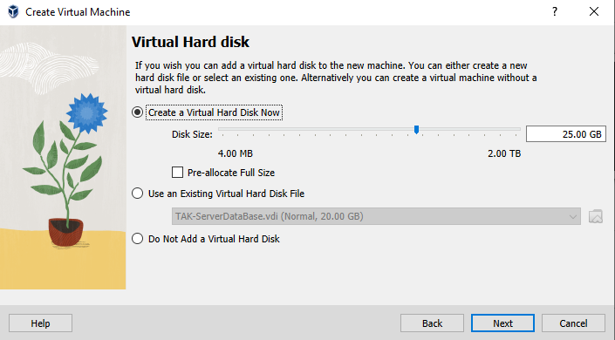
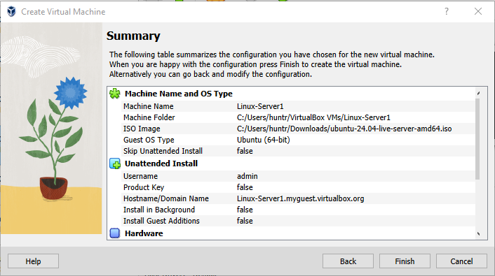
TAK Server - AD/LDAP Integration - LDAP Server Setup
Allocate the desired memory and CPU cores:
Ensure there is enough memory allocated to the disk:
Select “Finish”

Slide 6
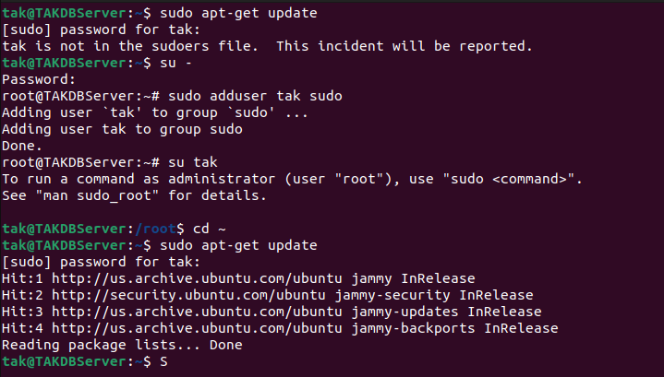
TAK Server - AD/LDAP Integration - User Setup
Walk through the setup process for the OS.
Once loaded, login.
If using Ubuntu provided above following these instructions:
Open a terminal and try using sudo: sudo apt-get update
If you get an error saying “the user is not in the sudoers file” do the following:
Enter root user:
su -
enter your password
promote the user:
sudo adduser <username> sudo
switch back to the user:
su <username>

Slide 7
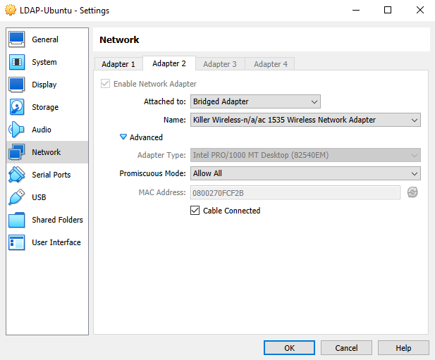
TAK Server - AD/LDAP Integration -Network Setup
Power off the server.
In the VM go to the server’s settings:
Display - > Remote Display:
Enable “Enable Server”
Enable “Allow Multiple Connections”
Network -> Adapter 2:
Enable “Enable Network Adapter”
Attached to “Bridged Adapter”
Advanced:
Promiscuous Mode: Allow All
Select “ok” and start the server

Slide 8
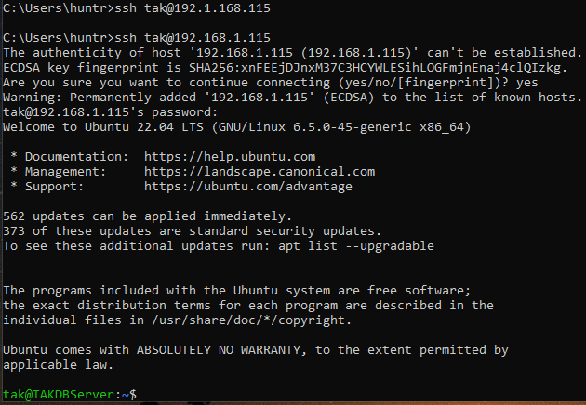
TAK Server - AD/LDAP Integration - Network Setup
Login and open terminal:
Install OpenSSH:
sudo apt install openssh-server -y
Install network tools:
sudo apt install net-tools
You should now be able to ssh into the server from your host machine.
ssh <username>@<IP address>
Find the IP address with: ifconfig

Slide 9
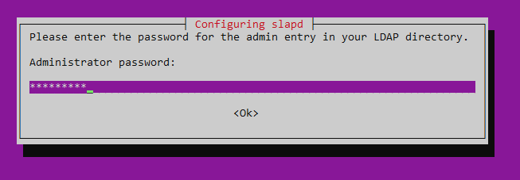
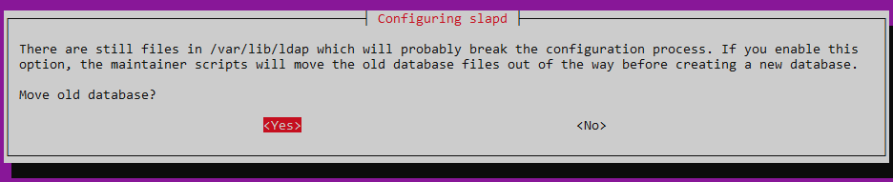
TAK Server - AD/LDAP Integration - Setup
Update your system:
sudo apt update
Install the OpenLDAP server and utilities:
sudo apt install slapd ldap-utils -y
You will be prompted to enter a password:
Password1
Configure OpenLDAP
sudo dpkg-reconfigure slapd
Omit OpenLDAP server Configuration: No
DNS Domain Name: tak.gov
Organization Name: Test.tak.gov
Password: Password1
Re-Enter Password: Password1
Remove Database when slapd is purged: NO
Move old data: Yes

Slide 10
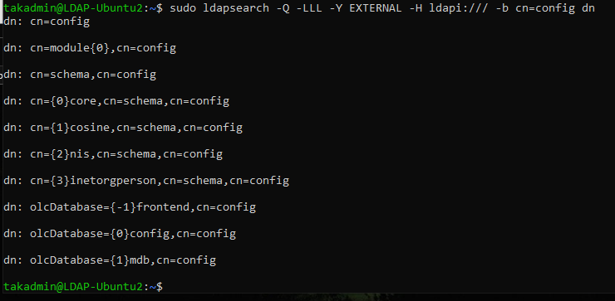
TAK Server - LDAP Integration - Setup
Check the status:
sudo systemctl status slapd
If the service is not running, start it:
sudo systemctl start slapd
To restart the service:
sudo systemctl restart slapd
To see the current backend configuration:
sudo ldapsearch -Q -LLL -Y EXTERNAL -H ldapi:/// -b cn=config dn

Slide 11
TAK Server - LDAP Integration - Setup
Search for the following schemas, if have them you don’t need add them again:
sudo ldapsearch -Q -LLL -Y EXTERNAL -H ldapi:/// -b cn=schema,cn=config dn
Import Additional Schemas:
core.ldif defines the fundamental object classes and attributes that are required by LDAP directories.
sudo ldapadd -Y EXTERNAL -H ldapi:/// -f /etc/ldap/schema/core.ldif
cosine.ldif includes additional object classes and attributes used for compatibility with x.500 directories.
sudo ldapadd -Y EXTERNAL -H ldapi:/// -f /etc/ldap/schema/cosine.ldif
nis.ldif extends the core schema with attributes and object classes used in Unix environments for presenting networked information.
sudo ldapadd -Y EXTERNAL -H ldapi:/// -f /etc/ldap/schema/nis.ldif
inetorgperson.ldif extends the organizationalPerson object class with attributes that are commonly used for internet and organizational applications.
sudo ldapadd -Y EXTERNAL -H ldapi:/// -f /etc/ldap/schema/inetorgperson.ldif
Notes:
# We need to import these schemas to provide a more robust foundation for our directories:

Slide 12
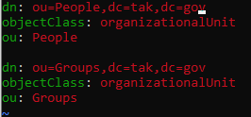
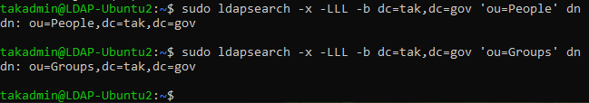
TAK Server - LDAP Integration - Setup
Add base schema and entries:
Create a LDIF file named base.ldif with the following content:
To create a file: vim base.ldif
Add the entries to the LDAP directory (replace tak.gov with your domain):
sudo ldapadd -x -D cn=admin,dc=tak,dc=gov -W -f base.ldif
Verify the entires:
sudo ldapsearch -x -LLL -b dc=tak,dc=gov ‘ou=People’ dn
sudo ldapsearch -x -LLL -b dc=tak,dc=gov ‘ou=Groups’ dn
Notes:
# You can use any text editor of your choice, to install vim: sudo apt install vim

Slide 13
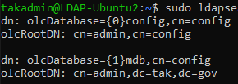

TAK Server - LDAP Integration - Setup
Change LDAP Administrator password:
Search the LDAP configuration database to see how the DN is configured:
sudo ldapsearch -Q -LLL -Y EXTERNAL -H ldapi:/// -b cn=config “(olcRootDN=*)” olcRootDN
Generate a new hashed password:
sudo slappasswd
Enter a password and when complete copy the generated SSHA password.
Create a new LDIF file named “change_password.ldif” with the following content:
Change the SSHA password to the one you generated.
Apply the LDIF file to change the password:
sudo ldapmodify -Q -Y EXTERNAL -H ldapi:/// -f change_password.ldif

Slide 14

TAK Server - LDAP Integration - Setup
Adding organizational units (OU)
Create a new LDIF file called add_org_unit.ldif
Add the following to it:
Add the OU:
ldapadd -x -D “cn=admin,dc=tak,dc=gov” -W -f add_org_unit.ldif
Verify the OU has been added:
ldapsearch -x -LLL -b dc=tak,dc=gov “(ou=Engineering)” dn

Slide 15
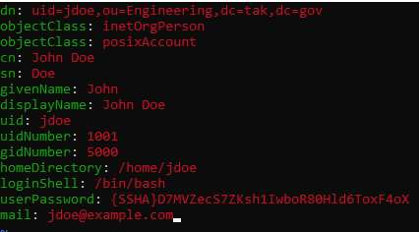

TAK Server - LDAP Integration - Setup
Adding users:
To add a new user to the Engineering OU that we just created, create a new LDIF file and add the following:
You can create a new SSHA password to use.
You can also change the name and other attributes to whatever you’d like.
Once done save and exit the file then add the user to the Engineering OU:
ldapadd -x -D “cn=admin,dc=tak,dc=gov” -W -f add_user_to_engineering.ldif
Verify the user was added:
ldapsearch -x -LLL -b dc=tak,dc=gov “(uid=jdoe)” dn

Slide 16

TAK Server - LDAP Integration - Setup
Modifying Entries:
Create a LDIF file called modify_user.ldif with the following:
This changes the users email address.
User the modify command to modify the user:
ldapmodify -x -D “cn=admin,dc=tak,dc=gov” -W -f modify_user.ldif
Verify the changes:
ldapsearch -x -LLL -b dc=tak,dc=gov “(uid=jdoe)” mail

Slide 17
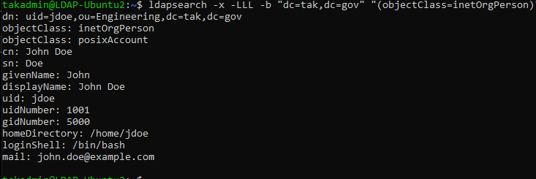
TAK Server - LDAP Integration - Setup
Searching entries:
Search for all users:
ldapsearch -x -LLL -b “dc=tak,dc=gov” “(objectClass=inetOrgPerson)”
Searching for a specific user:
ldapsearch -x -LLL -b “dc=tak,dc=gov” “uid=jdoe”

Slide 18

TAK Server - LDAP Integration - Setup
Changing Passwords:
Create a new password:
sudo slappasswd
Create a new LDIF file called change_user_password.ldif with the following content:
Commit the changes:
ldapmodify -x -D “cn=admin,dc=tak,dc=gov” -W -f change_user_password.ldif

Slide 19
TAK Server - LDAP Integration - Setup
Backup and restore:
To backup the LDAP database:
sudo slapcat -n 1 -l backup.ldif
To restore the LDAP database:
Stop the service:
sudo systemctl stop slapd
Restore the database:
sudo slapadd -n 1 -l backup.ldif
To start the LDAP service:
sudo systemctl start slapd
To verify the restoration:
ldapsearch -x -LLL -b “dc=tak,dc=gov” “(objectClass=*)”

Slide 20
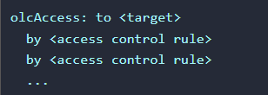
TAK Server - LDAP Integration - Setup
Access Control Lists (ACLs) allow for fine-grained control over who can read, write and manage directory entries and attributes.
ACLs are critical for securing you LDAP directory and ensuring that only authorized users can access or modify sensitive information.
ACLs are defined in the OpenLDAP configuration files and are structured as follows:
Target: speficies the directory entries or attributes the ACL applies to.
Access Control Rule: Defines who can perform what actions on the target.

Slide 21
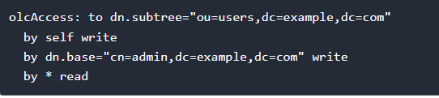
TAK Server - LDAP Integration - Setup
Example of ACL:
Add the ACL file:

Slide 22
TAK Server - LDAP Integration - Setup
Deleting Entries:
Command to delete a user:
Verify the user has been deleted:
Command to delete an OU:
Verify the OU has been deleted:

Slide 23
TAK Server - LDAP Integration - Setup
Install Apache Directory Studio:
https://directory.apache.org/studio/
In the top left select: “File” -> “New” -> LDAP Browser -> LDAP Connection.
Give it a name and then enter in the IP address of the server.
Select “Next”
Authentication:
Bind DN: cn=admin,dc=tak,dc=gov
Bind Password: password
Select “Check Authentication”
If successful select “Finish”

Slide 24
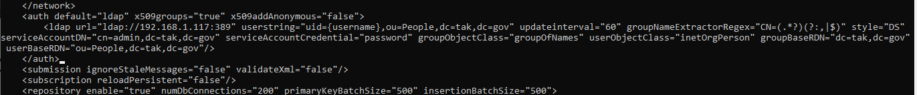
TAK Server - LDAP Integration - Setup
Open up you TAK Server CoreConfig.xml file from the tak user:
vim /opt/takCoreConfig.xml
Make the following changes:
Validate the changes in the tak use:
cd ~
./validateConfig.sh
Restart the server (from outside the tak user):
sudo systemctl restart takserver
Notes:
# Note the <File/> will pop up on restart and cause validate issues but its ok.

Slide 25
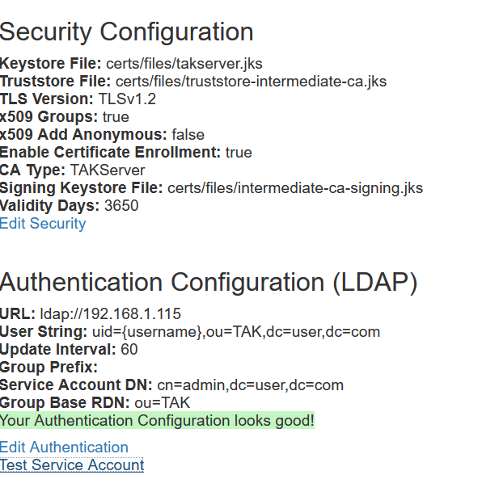
TAK Server - LDAP Integration - Connecting our TAK Server
From our server dashboard the configuration menu should look as follows:
In our TAK Server dashboard: Hamburger menu -> Configuration -> Security and Authentication
Select “Edit Authentication”
URL: ldap://192.168.1.115:389
User String: cn={username},ou=People,dc=tak,dc=gov
Update Intervals: 60
Service Account DN: cn=admin,dc=tak,dc=gov
Security Account Password: Password1
Group Base RDN: dc=tak,dc=gov

Slide 26
TAK Server - LDAP Integration - Connecting our TAK Server
You can validate if you did it correctly by opening up a browser and entering in: <IP address>:8446
The IP address is that of your TAK Server and the specific port will bring you to WebTAK login.
From there you can enter in the credentials you entered for the users you created on the LDAP service to login.
If you successfully are logged in you have done everything correctly.

Slide 27
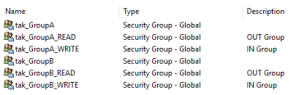
TAK Server - LDAP Integration
IN and OUT Groups with LDAP:
To apply the in/out filters to a group with LDAP you need to create an additional group with the same naming but with either “_READ” or “_WRITE” at the end of the name.
_READ: out group
_WRITE: in group
If you somehow forget to add a user to a group, they will default to the __ANON__ group when they authenticate to the TAK Server.

Slide 28
Resources:
https://www.golinuxcloud.com/install-and-configure-openldap-on-ubuntu-step-by-step/
https://docs.oracle.com/en/operating-systems/oracle-linux/6/admin/ldap-addusers-group.html
https://serverfault.com/questions/514870/how-do-i-authenticate-with-ldap-via-the-command-line

